Slide 1
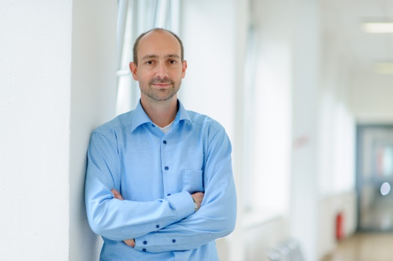
Chapter 4.4
Customer Retrial Model with Finite Number of Sources
Performance Evaluation of the Internet of Things (IoT)
Module Course: Performance Evaluation of Distributed Systems
Prof. Tobias Hoßfeld, Summer Semester 2022

Slide 2
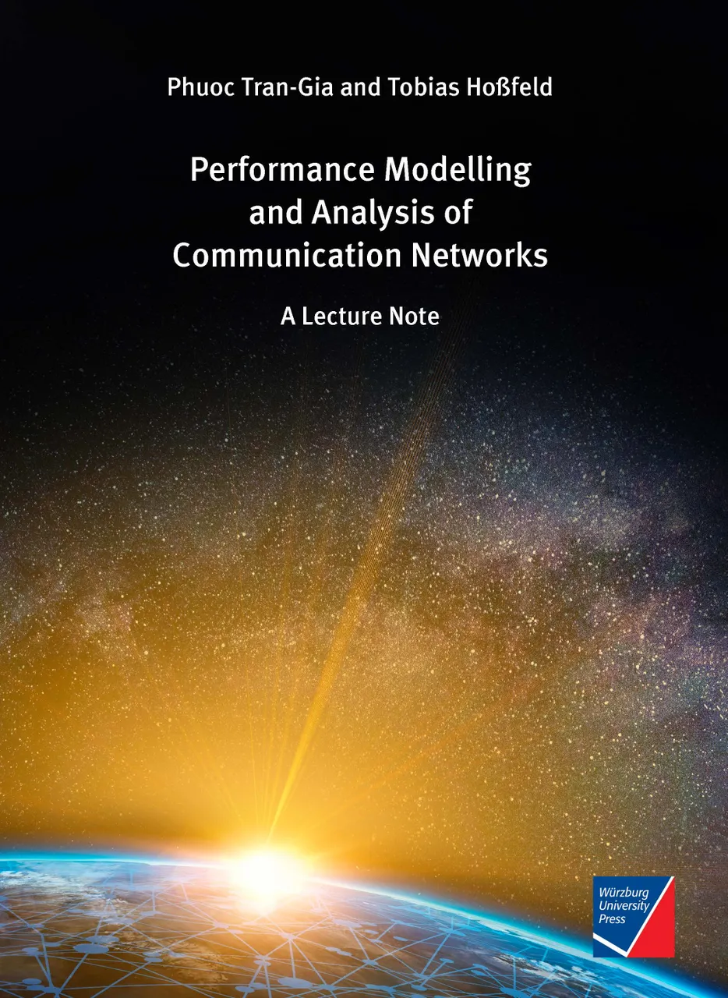
Disclaimer and Copyright Notice
Lecture slides, figures, and scripts are based on the open access text book “Performance Modeling and Analysis of Communication Networks”. The book and scripts are licensed under the Creative Commons License Attribution-ShareAlike 4.0 International (CC BY-SA 4.0). If you remix, transform, or build upon the material, you must distribute your contributions under the same license as the original.
The book must be cited and the disclaimer attached when using lectures slides or scripts.
Tran-Gia, P. & Hossfeld, T. (2021). Performance Modeling and Analysis of Communication Networks - A Lecture Note. Würzburg University Press. https://doi.org/10.25972/WUP-978-3-95826-153-2
Website to download book, exercises, slides and scripts: https://modeling.systems/

Slide 3
Chapter 4
4 Analysis of Markovian Systems
4.1 Loss System M/M/n
4.1.1 Model Structure and Parameters
4.1.2 State Process and State Probabilities
4.1.3 Other System Characteristics
4.1.4 Generalization to Loss System M/GI/n
4.1.5 Modeling Examples and Applications
4.2 Delay System M/M/n
4.2.1 Model Structure and Parameters
4.2.2 State Process and State Probabilities
4.2.3 Other System Characteristics
4.2.4 Delay Distribution
4.2.5 Example: Single Server Delay System
4.3 Loss System with Finite Number of Sources
4.3.1 Model Structure and Parameters
4.3.2 State Process and State Probabilities
4.3.3 Example: Mobile Cell with Finite Number of Sources
4.4 Customer Retrial Model with Finite Number of Sources
4.4.1 Model Structure and Parameters
4.4.2 Recursive Analysis Algorithm
4.4.3 Calculation of Traffic Flows
4.4.4 Example: Mobile Cell with Customer Retrials
4.5 Processor Sharing Model M/M/1-PS

Slide 4
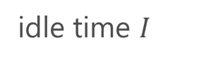
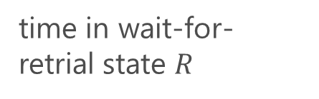
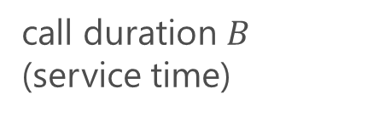
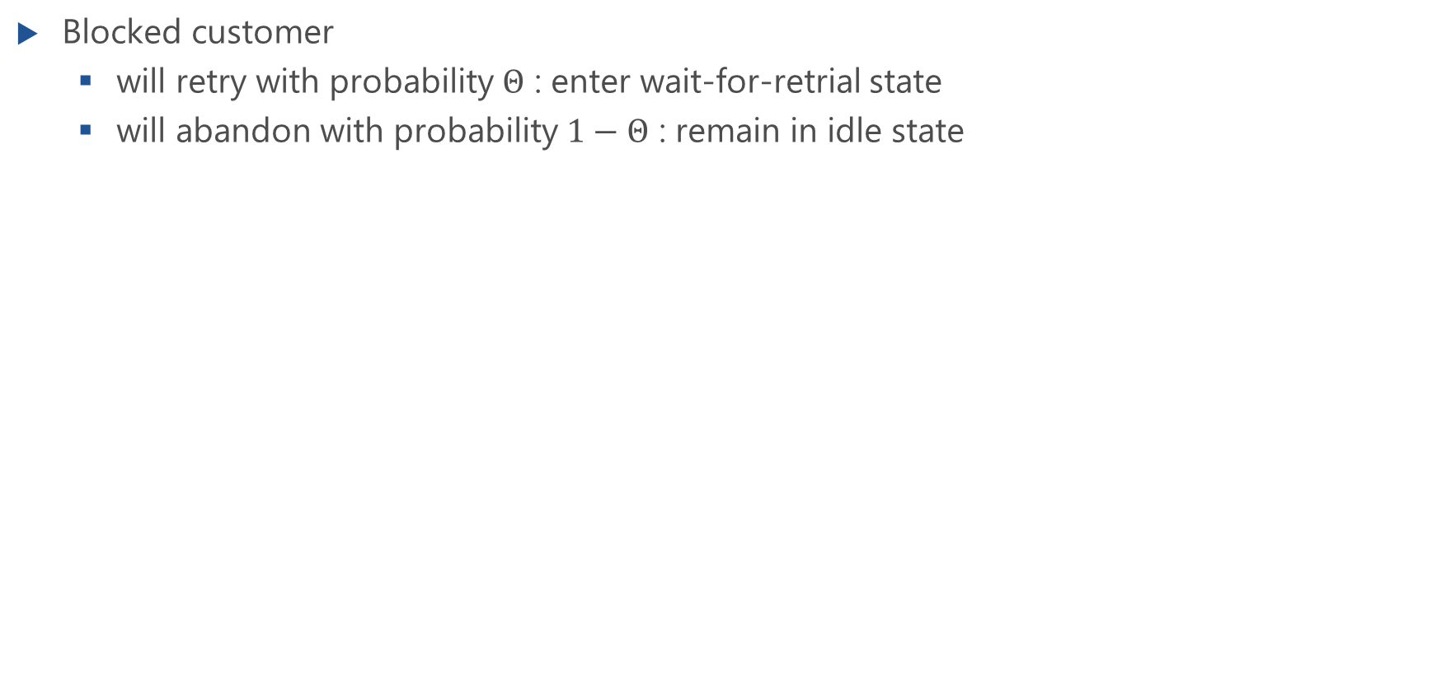
Model of Customer Behavior with Retrial
Blocked customer
will retry with probability $Θ$ : enter wait-for-retrial state
will abandon with probability $1−Θ$ : remain in idle state
call duration $B$ (service time)
idle time $I$
time in wait-for-retrial state $R$

Slide 5
Retrial Model

Slide 6
Model Parameters

Slide 7
State Transition Diagram
Lecture

Slide 8
State Transition Diagram (f.)
Lecture

Slide 9
State Transition Diagram
Can be solved numerically
See notebook script at https://modeling.systems/

Slide 10
Traffic Flows

Slide 11
Traffic Flows of Fresh Calls
blocking probabiltiy for fresh calls

Slide 12
Mean Number of Attempts for Successful Calls
Mean number of attempts for successful calls

Slide 13
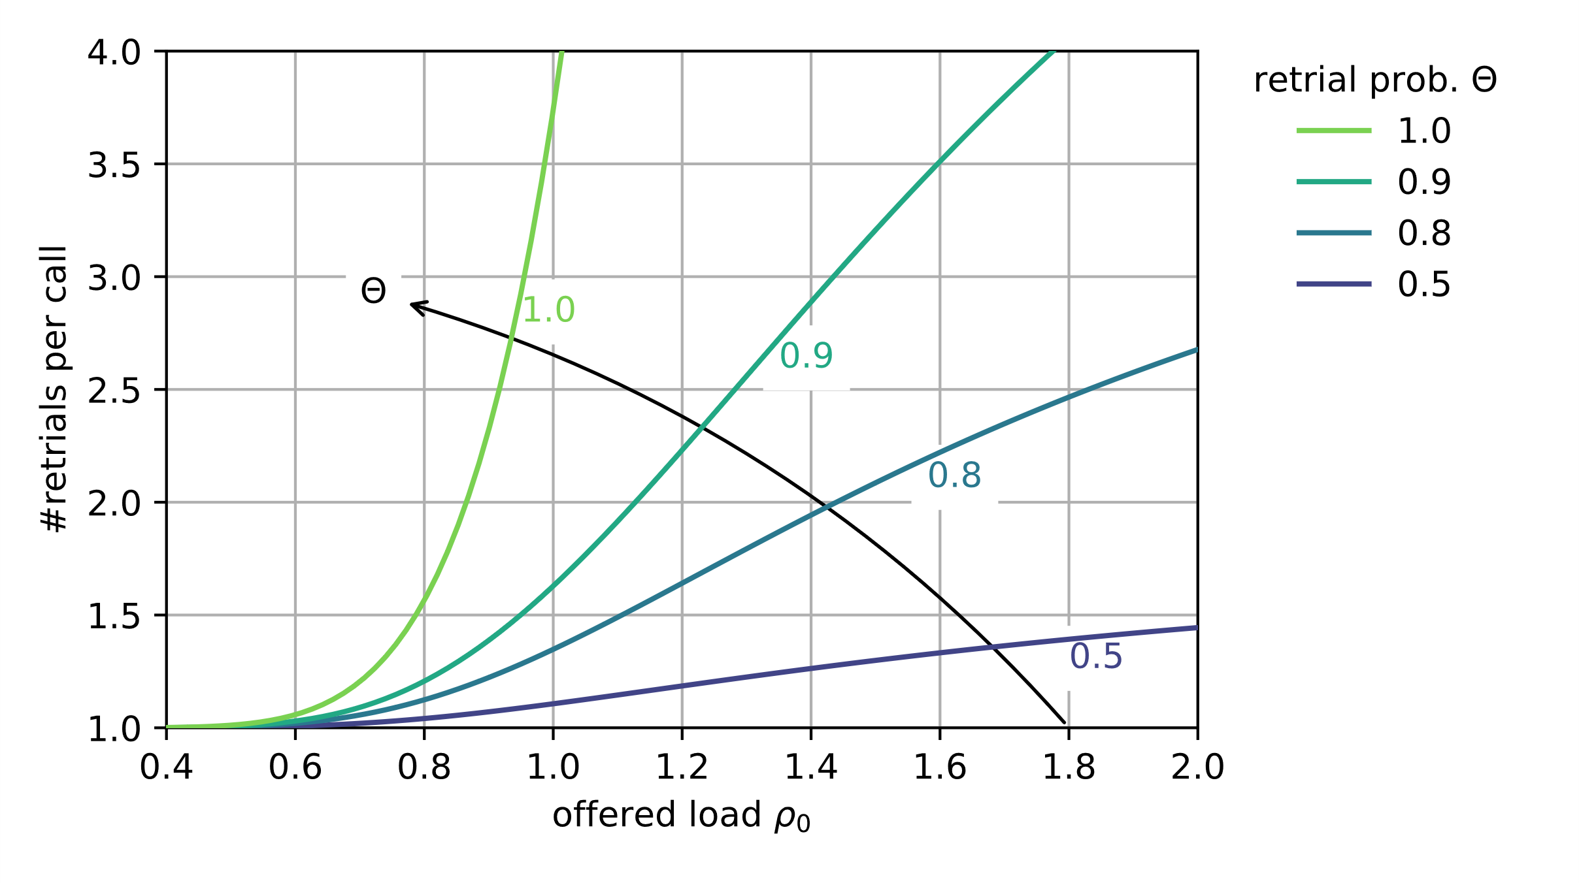
Results: Retrial Model

Slide 14
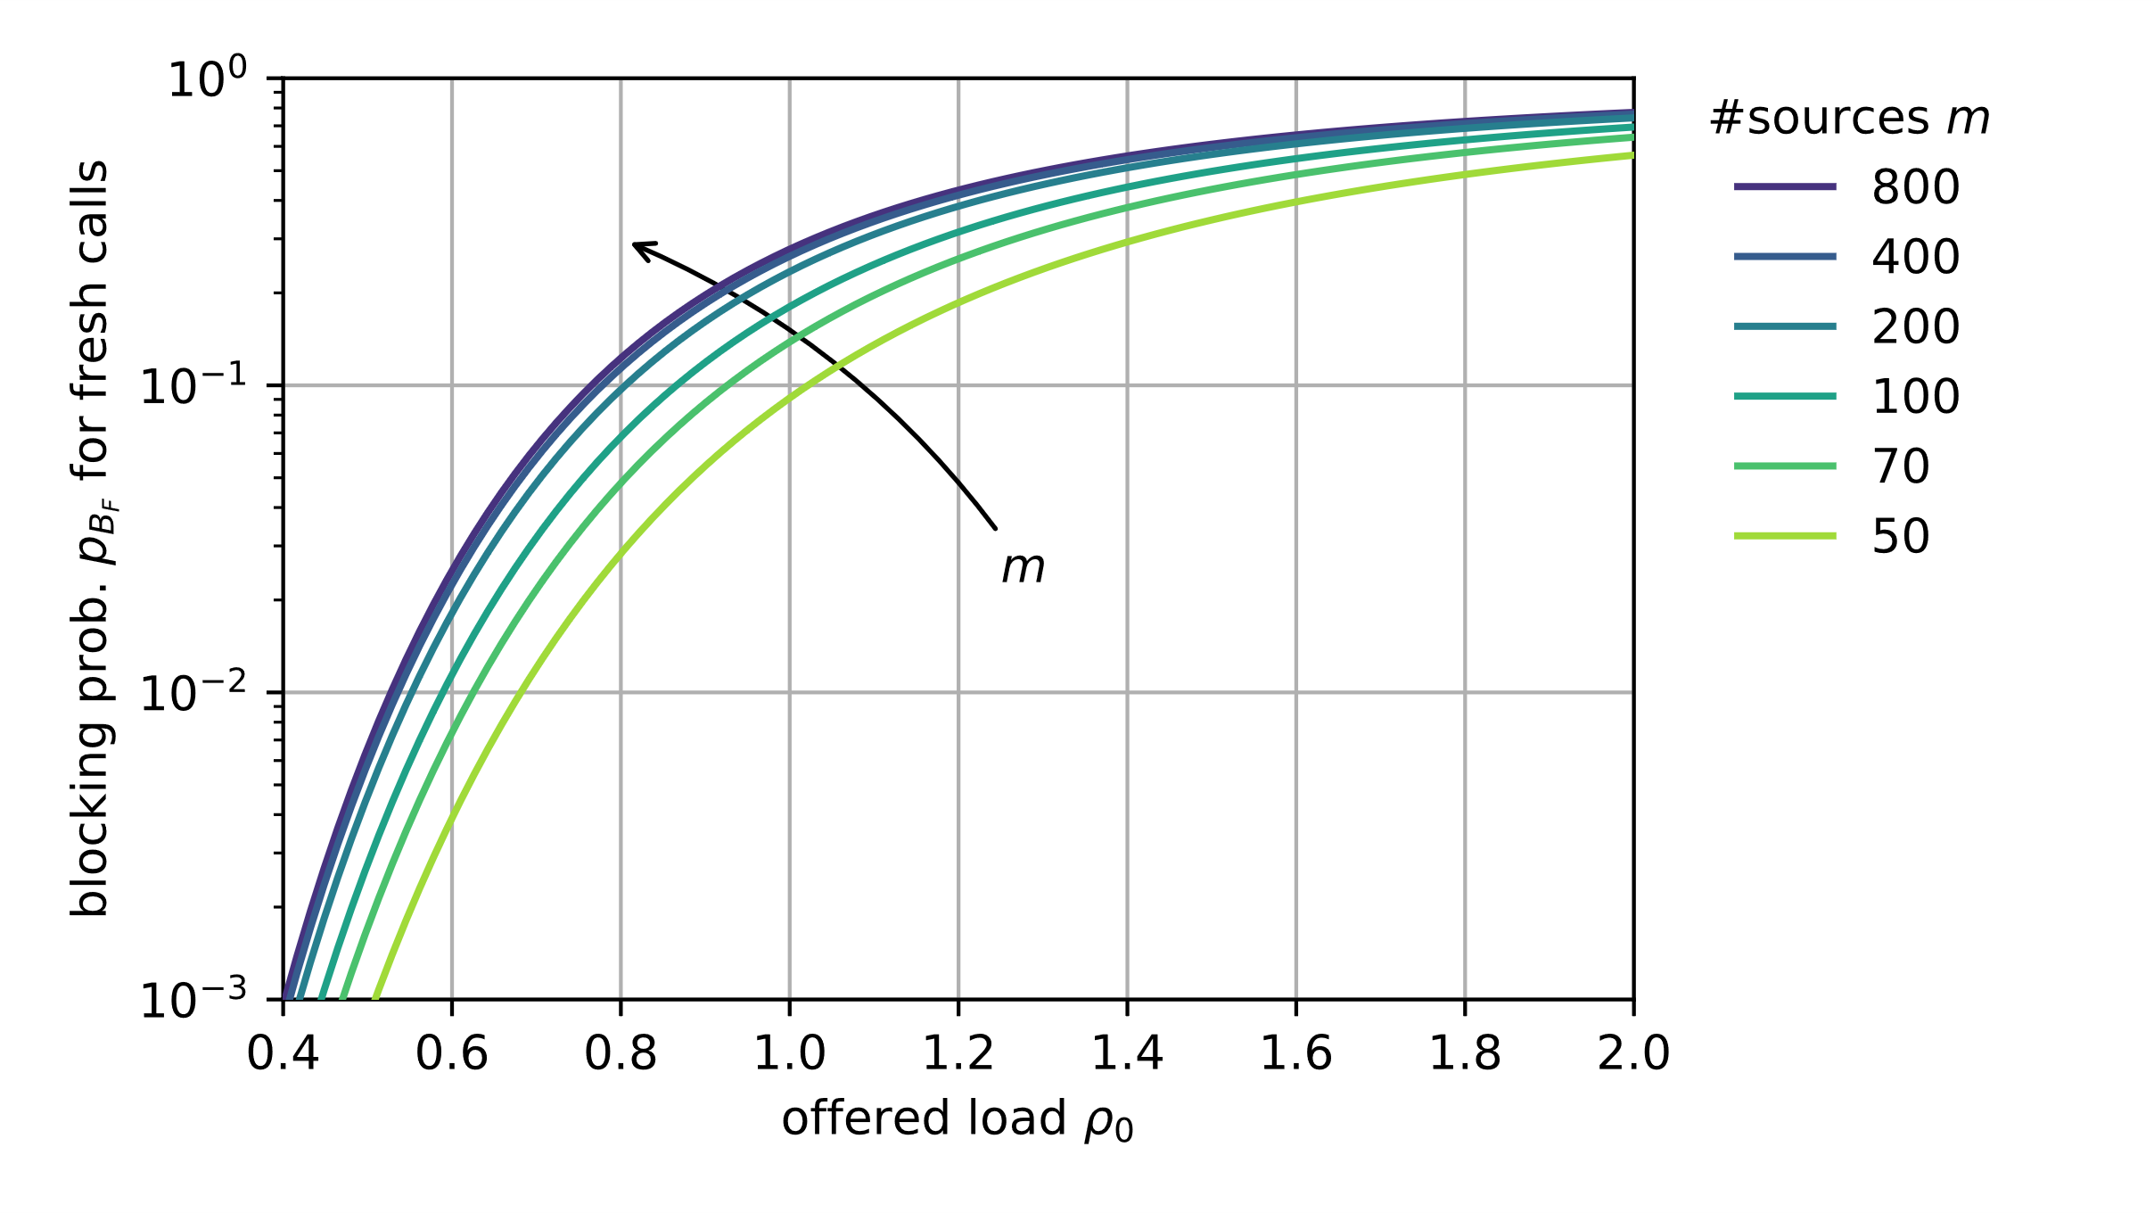
Results: Retrial Model

